Slide 1
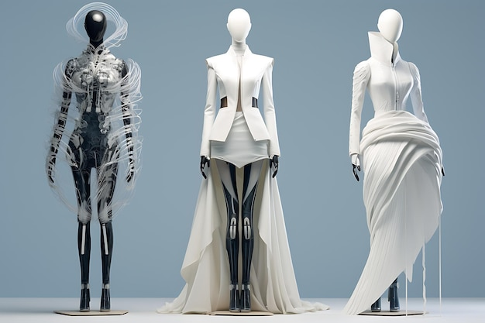
Sketch2Style:
A Controllable AI Fashion Design
Using Diffusion Models & Sketch Conditioning
Group 3:
Rupali Ravindra Shetye
Kartavya Mandora
Date: 2nd Apr 2026
AI688-001_BK_Spring 2026
Source: https://www.freepik.com/premium-ai-image/aidriven-fashion-design-future-vision_83711218.htm

Slide 2
OUTLINES
Introduction
Application
Literature Review
Literature Review Results
Methodology
Model Architecture
Dataset
Understanding the Functions
Training Strategy
Obtained Results
Conclusion & Future Work
Team Contribution
Timeline
References

Slide 3
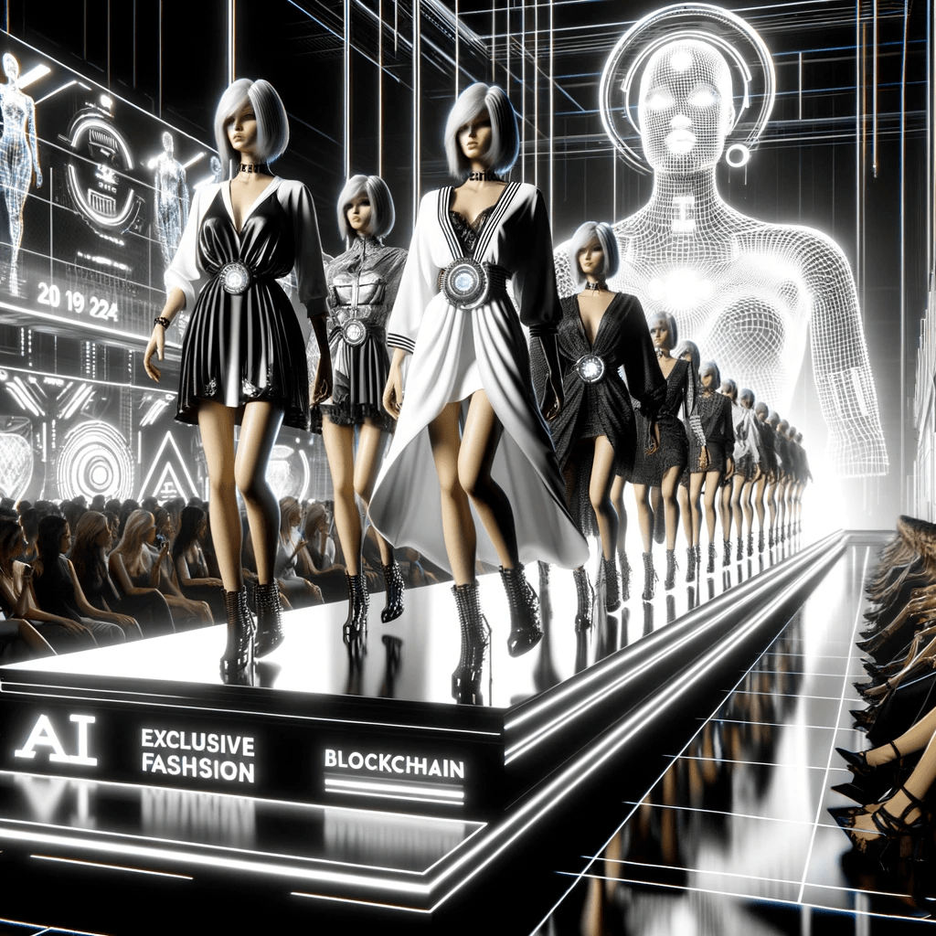
INTRODUCTION
Fashion design starts from sketches
Designers need structure + style control
Diffusion models generate realistic images
BUT lack spatial control
Source: https://davincinext.com/2024/01/22/ai-web3-fashion-revolution-202/

Slide 4
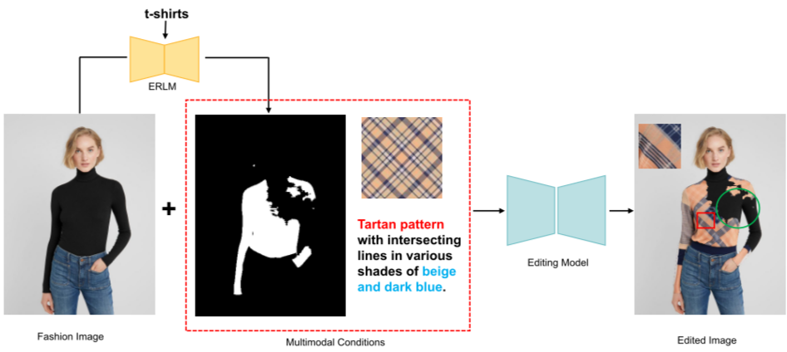
INTRODUCTION
Problem Statement
Current AI tools suffer from:
❌ Cannot preserve sketch geometry
❌ Output not aligned with designer intent
Our solution directly addresses each gap:
  ✔ Sketch-conditioned generation using ControlNet
  ✔ Text prompts for style consistency
  ✔ Gradio interface for usability
Source: https://www.themoonlight.io/en/review/dpdedit-detail-preserved-diffusion-models-for-multimodal-fashion-image-editing

Slide 5
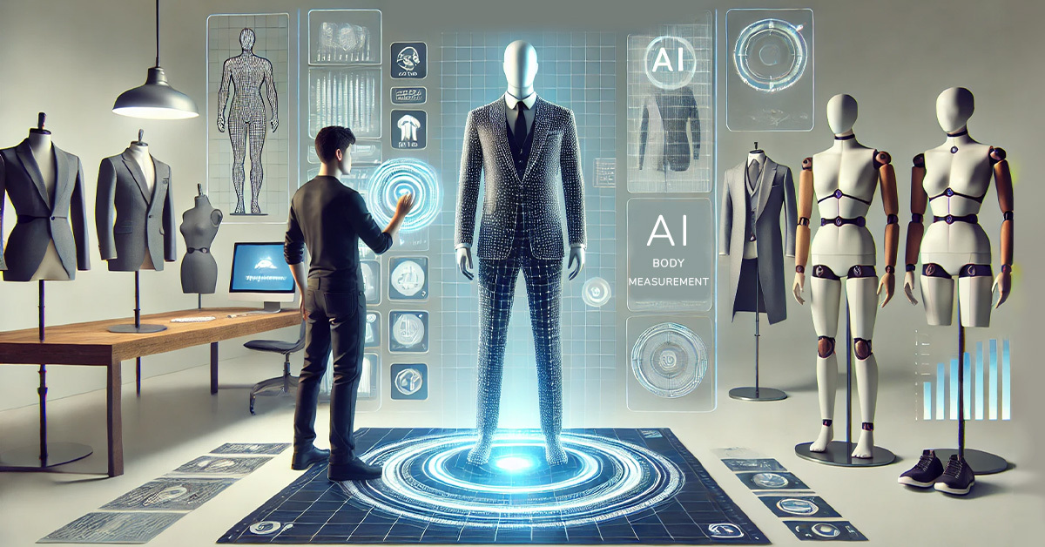
APPLICATION
AI-assisted fashion prototyping
Rapid design exploration
Cost reduction
Support for small designers
Creative exploration tool
Source: https://www.mirrorsize.com/blogs/custom-fits-in-clicks-ais-role-in-made-to-measure-apparel

Slide 6
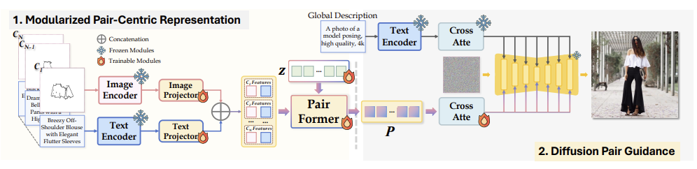
LITERATURE REVIEW
Paper 1: LOTS (ICCV 2025)
Title: LOTS of Fashion
Multi-conditioning diffusion
Sketch + Text pairing
Modular attention-based merging
Introduced Sketchy dataset
Improved attribute localization
Source: F. Girella et al.

Slide 7
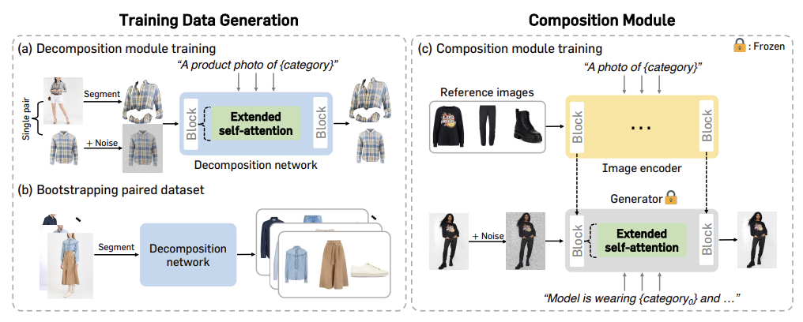
LITERATURE REVIEW
Paper 2: BootComp (CVPR 2025)
Title: Controllable Human Image Generation
Multi-garment conditioning
Two-stage pipeline
Synthetic paired data generation
Extended self-attention
+30% improvement in MP-LPIPS(Multi-Scale Learned Perceptual Image Patch Similarity)
Source: Y. Choi et al.

Slide 8
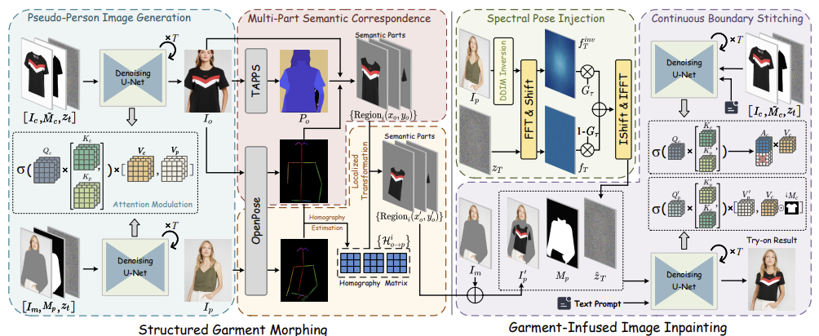
LITERATURE REVIEW
Paper 3: OmniVTON (ICCV 2025)
Title: Training-Free Universal Virtual Try-On
Structured Garment Morphing
Spectral Pose Injection
Continuous Boundary Stitching
Training-free approach
Strong pose consistency
Source: Z. Yang et al.

Slide 9
LITERATURE REVIEW RESULTS
Aspect | LOTS | BootComp | OmniVTON
Objective | Sketch-text generation | Multi-garment control | Training-free try-on
Conditioning | Sketch + Text | Multi-garment images | Pose + garment
Training | Fully trained | Trained | Training-free
Strength | Layout accuracy | Texture fidelity | Pose consistency
Limitation | Complex design | Not sketch-driven | Not design-focused
Research Gap
  No ControlNet-based fashion sketch system
  No study using Fashion-MNIST
  No simple designer-friendly implementation
  Need spatial enforcement via ControlNet
Our contribution: First ControlNet-based fashion generation on
Fashion-MNIST with accessible web interface

Slide 10
ALGORITHM/APPROACH/METHODOLOGY
Step 1 Dataset Exploration
Fashion-MNIST: 70,000 images, 10 clothing categories, Balanced dataset
Split: 9,600 training, 2,400 validation, 2,000 testing
Step 2 Data Preprocessing
Resize 28×28 → 256×256, Convert grayscale → RGB, Normalize: [1,-1], Apply Canny edge detection, Generate sketch maps
Step 3 Text Prompt Construction
Convert labels to descriptive prompts
Step 4 Model Pipeline
Edge map → ControlNet, Prompt → CLIP encoder, Random noise → Stable Diffusion v1.5, Dual conditioning during denoising, VAE decoder → Final image
Step 5 Training Strategy
Each sample includes: Target image, Edge map, Text prompt
Encode using CLIP
Provide semantic control
Training process: Add noise to latent, Predict noise residual, Keep base diffusion mostly frozen, Train ControlNet layers

Slide 11
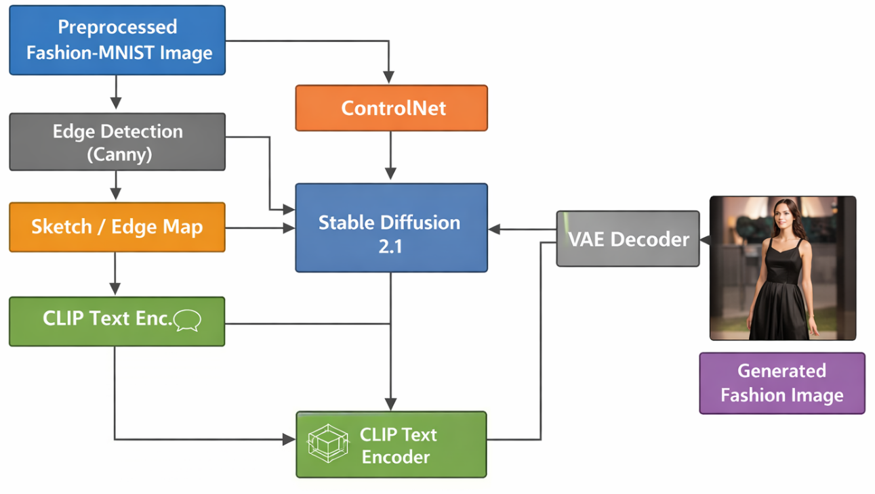
OVERALL WORKFLOW
1.5
Figure 1: Overall Workflow

Slide 12
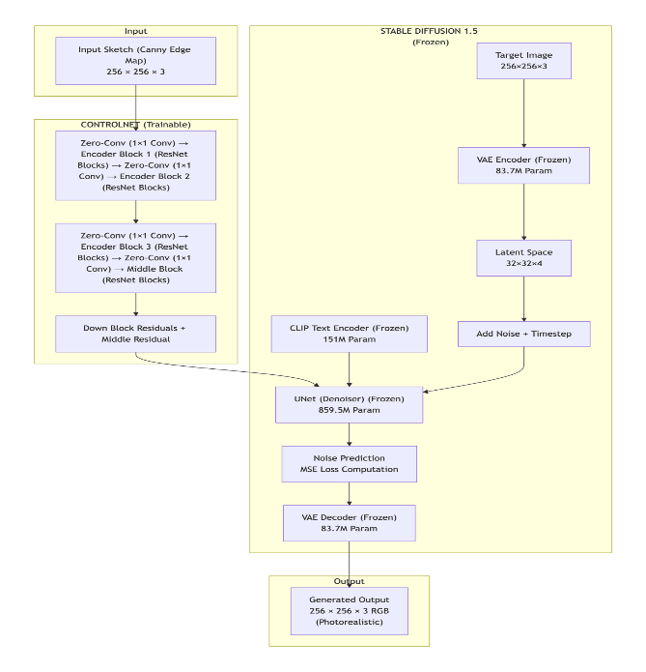
MODEL ARCHITECTURE
Figure 2: Model Architecture

Slide 13
DATASET STATISTICS
Dataset Name: Fashion-MNIST Overview
  Total Images: 70,000
  Image Type: 28 x 28 grayscale
  Categories: 10 balanced classes (7,000 each)
  Pixel Range: 0-255
Selected Categories for Midterm: Dress & Sneaker

Slide 14
DATASET DISTRIBUTION (SELECTED CATEGORIES)
Dataset Split After Filtering
Why 5,600 instead of 7,000?
  Original Fashion-MNIST has 7,000 images per category
  20% reserved for validation (1,400 per category)
  Remaining 80% used for training (5,600 per category)
Type | Samples
Training | 9,600
Validation | 2,400
Test | 2,000
Total | 16,000
Per Category Breakdown
Category | Training | Validation | Test | Total
Dress | 5,600 | 1,400 | 1,000 | 8,000
Sneaker | 5,600 | 1,400 | 1,000 | 8,000
Combined | 11,200 | 2,800 | 2,000 | 16,000

Slide 15
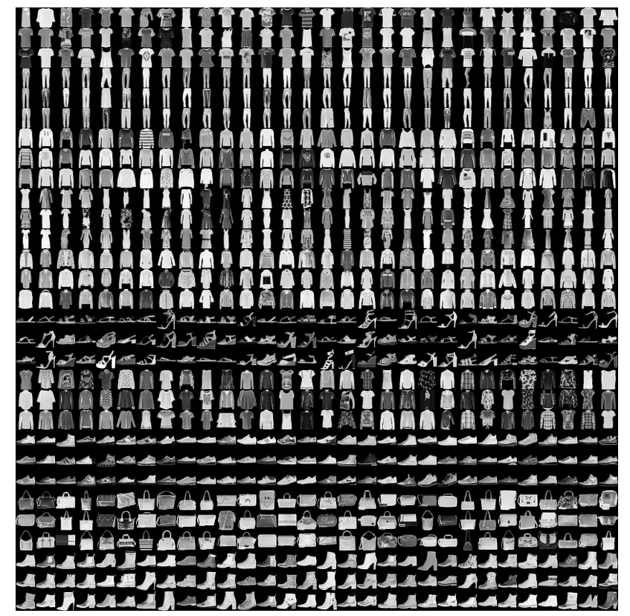
DATASET EXPLORATION
Source: https://www.kaggle.com/code/gpreda/cnn-with-tensorflow-keras-for-fashion-mnist

Slide 16
PRE-TRAINED MODEL SELECTIONS
Stable Diffusion Versions
ControlNet Variants
Version | Text Encoder | Resolution | Parameters | Key Characteristics
v1.4 | CLIP ViT-L/14 | 512×512 | 860M | First widely released version
v1.5 | CLIP ViT-L/14 | 512×512 | 860M | Improved image quality, best ControlNet compatibility
v2.0 | OpenCLIP | 768×768 | 865M | Larger text encoder, higher resolution
v2.1 | OpenCLIP | 768×768 | 865M | Refined version of v2.0
Variant | Conditioning Input | Best Use Case | Selected
Canny | Edge maps | Sketch preservation, structural control | YES
Depth | Depth maps | 3D structure preservation | NO
Pose | Human keypoints | Human pose control | NO
Scribble | Rough sketches | Freehand drawing | NO
MLSD | Line detection | Architectural drawings | NO
Normal | Normal maps | Surface detail control | NO
Selected: v1.5 because it offers best compatibility with ControlNet and lower computational requirements for T4 GPU training.
Selected: Canny variant because Fashion-MNIST edge maps closely match designer sketches and provide precise structural guidance for garment shapes.

Slide 17
MODEL PARAMETER SUMMARY
Trainable vs Frozen Parameters
Component | Parameters | Trainable | Status
Stable Diffusion UNet | 859,520,964 | 0 | Frozen
Stable Diffusion VAE | 83,700,000 | 0 | Frozen
CLIP Text Encoder | 151,000,000 | 0 | Frozen
ControlNet | 361,279,120 | 361,279,120 | Trainable
TOTAL | 1,455,500,084 | 361,279,120 | 24.8% Trainable
Key Insight: Only ControlNet (361.3M parameters) is trained. Base model remains frozen.

Slide 18
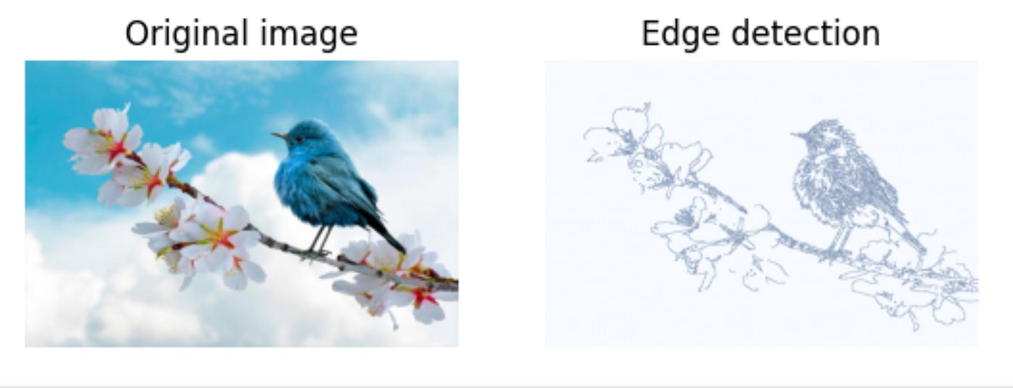
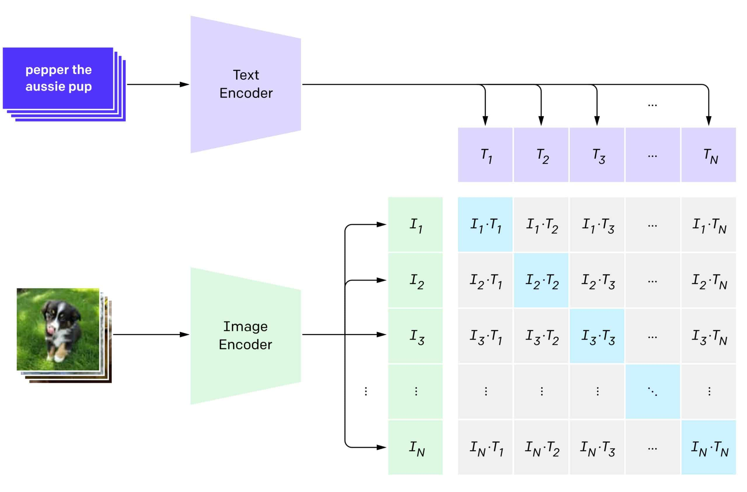
UNDERSTANDING THE FUNCTIONS
Role of Each Model
Stable Diffusion v1.5:
  Generates realistic images with UNet
ControlNet:
  Enforces sketch structure
CLIP(Contrastive Language-Image Pre-training):
  Guides semantic meaning by text prompts
  Used Constant prompt:
  Ex: “a sneaker, fashion product photo, studio lighting, high quality”
VAE (Variational Autoencoder):
  Encodes and decodes images
Source: https://medium.com/the-bytedoodle-blog/canny-edge-detection-deb0d62a8003
Source: https://viso.ai/deep-learning/clip-machine-learning/

Slide 19
TRAINING STRATEGY
Train only ControlNet
Freeze:
  UNet
  VAE
  CLIP
Batch size = 2
Steps ≈ 24,000 (for 5 epochs)
Stable convergence

Slide 20
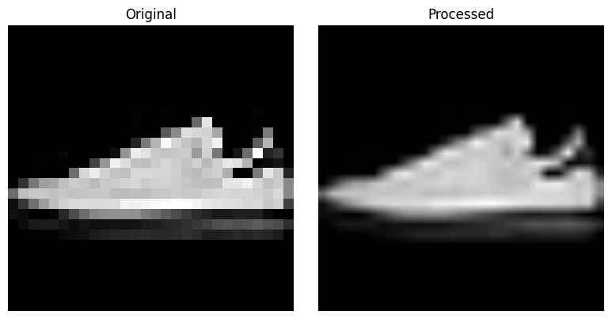
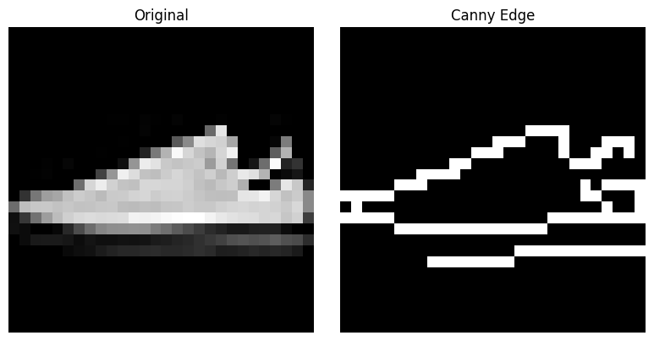
OBTAINED RESULTS
Preprocessing
Canny Edge
Detection

Slide 21
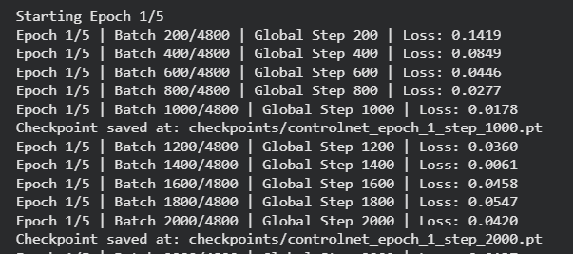
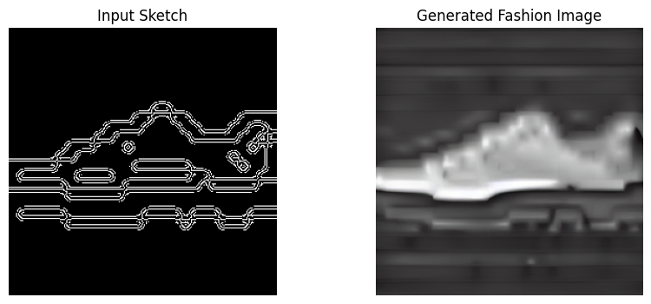
OBTAINED RESULTS
Training
Image Generation
or Testing

Slide 22
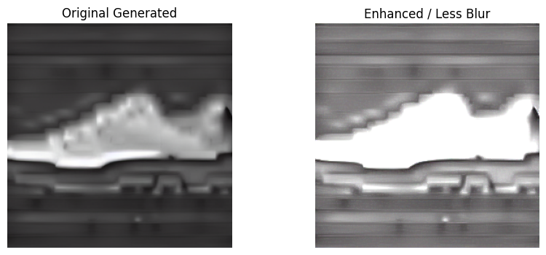
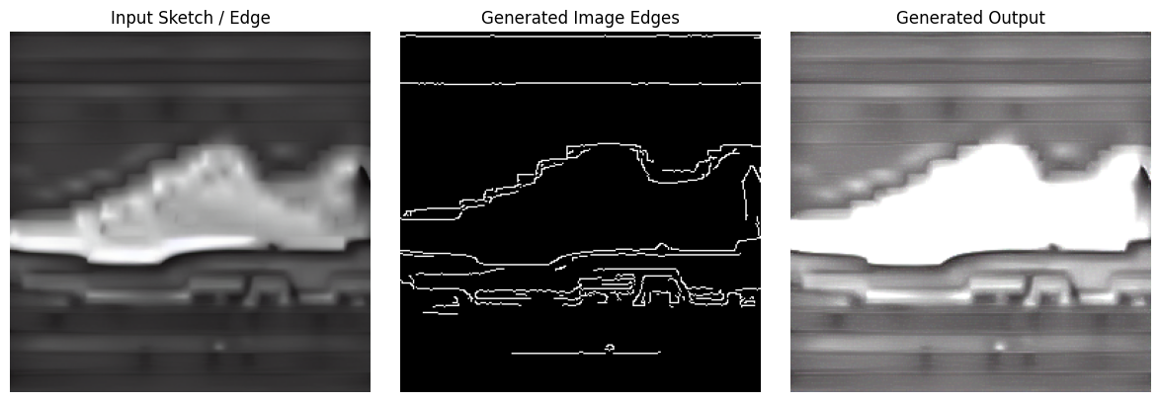
OBTAINED RESULTS
Sharpen Image
Evaluation

Slide 23
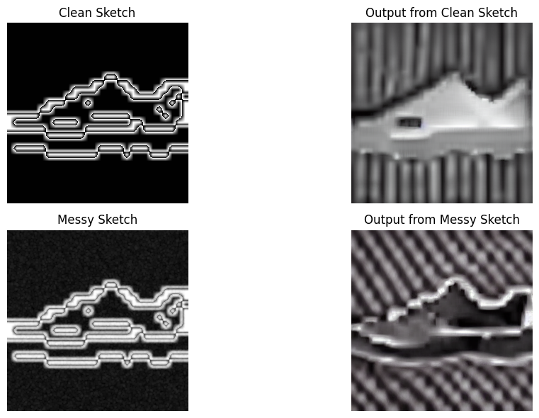
OBTAINED RESULTS
Comparison b/w Clean Sketch & Messy Sketch

Slide 24
OBTAINED RESULTS
Training Result:
Initial loss ≈ 0.12
Final loss ≈ 0.0025
No NaN issues
Stable convergence
Observations
Preserves garment structure
Generates realistic shapes
Text prompt influence visible
Model remains stable
Recognizable output
Slight Quality Drop
Metric | Value
SSIM(Structural Similarity Index Measure) | -0.0024
CLIP Score(Contrastive Language-Image Pre-training) | 0.1854
Inference Time | ~2 sec

Slide 25
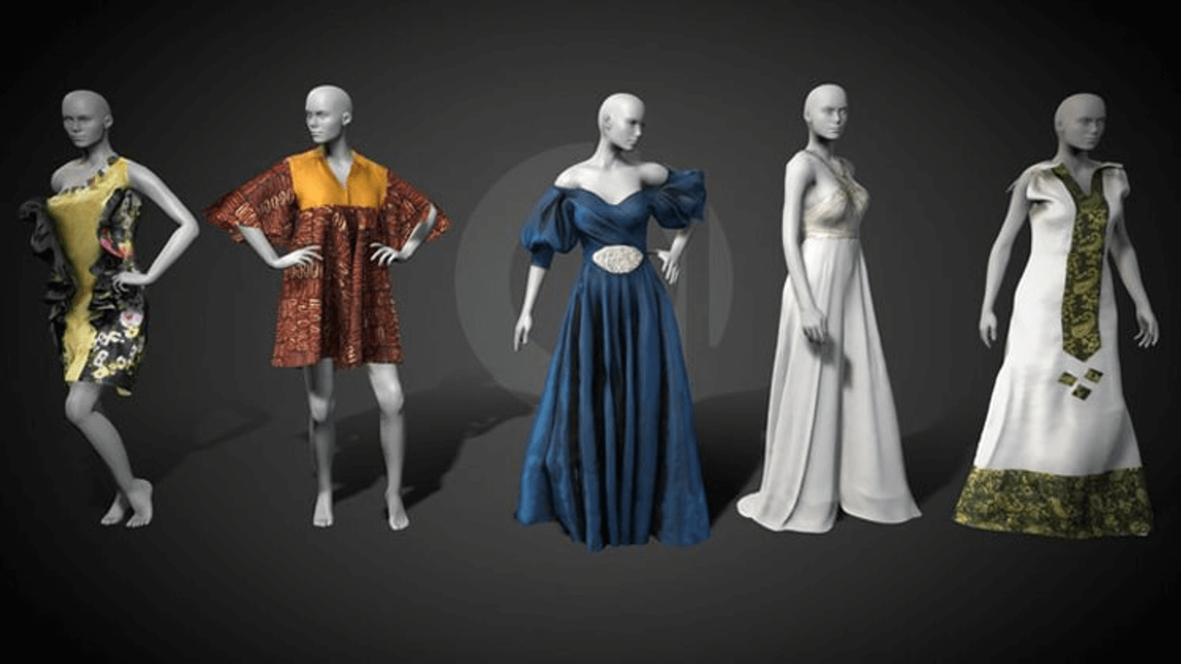
CONCLUSION & FUTURE WORK
Conclusion:
Successfully built sketch-conditioned system
ControlNet enables structural control
Pipeline works end-to-end
Future Work:
Try to implement more categories
Increase resolution (512×512)
Add FID metric
Improve training time
Add user sketch interface and human evaluation
Conclusion
Source: https://www.lezhougarment.com/ultimate-guide-to-3d-fashion-design-the-future-of-fashion/

Slide 26
ETHICAL CONSIDERATIONS
Aspect | Summary
Data Ethics | Public Fashion-MNIST dataset; no human subjects; 70,000 images across 10 categories
Model Ethics | Open source (MIT License); reproducible with fixed random seeds; balanced representation
Scientific Integrity | Results reported honestly; all prior work properly cited
Dual Use | Academic research only; assists designers, not replaces creativity
Environmental Impact | 2.5 kg CO2 (equivalent to driving 10 miles)

Slide 27
TEAM-WORK DISTRIBUTION
Team Member | Primary Contributions | Responsibilities
RUPALI | • Project Lead & Architecture Design • Literature Review Coordination • Model Architecture Design • Final Report Compilation | • Led weekly team meetings and coordinated project timeline • Design ControlNet + Stable Diffusion architecture • Coordinate literature review across 10 papers • Integrate all sections into final proposal
KARTAVYA | • Data Acquisition & Preprocessing • Edge Detection Pipeline • Implementation Lead • Results Documentation | • Download and process Fashion-MNIST dataset • Implement Canny edge detection pipeline • Develop Gradio web interface • Document technical implementation details

Slide 28
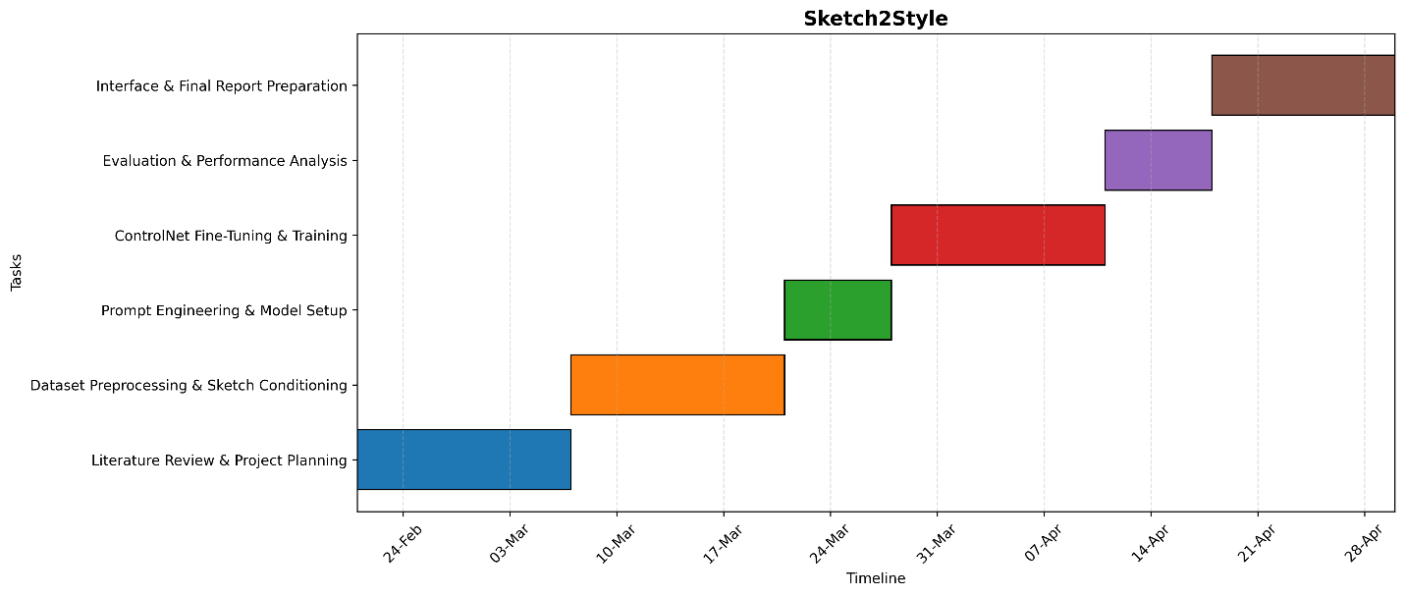
TIMELINE
Figure 3: Gantt Chart

Slide 29
REFERENCES
[1] R. Rombach et al., "High-Resolution Image Synthesis with Latent Diffusion Models," CVPR, 2022.
[2] L. Zhang et al., "Adding Conditional Control to Text-to-Image Diffusion Models," ICCV, 2023.
[3] H. Xiao et al., "Fashion-MNIST: A Novel Image Dataset," arXiv, 2017.
[4] D. Podell et al., "SDXL: Improving Latent Diffusion Models," ICLR, 2024
[5] C. Mou et al., "T2I-Adapter: Learning Adapters for Text-to-Image Diffusion," AAAI, 2024.
[6] F. Girella et al., "LOTS of Fashion! Multi-Conditioning for Image Generation," ICCV, 2025.
[7] Y. Choi et al., "Controllable Human Image Generation with Personalized Multi-Garments," CVPR, 2025.
[8] Z. Yang et al., "OmniVTON: Training-Free Universal Virtual Try-On," ICCV, 2025.

Slide 30
Questions

